Slide 1
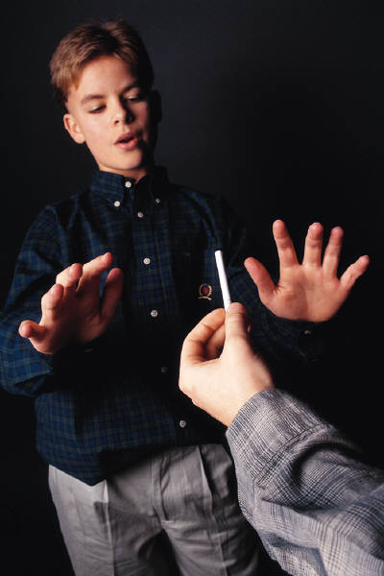
Peer Pressure

Slide 2
Who is Peers?
Peers are those who are similar and of the same age group.

Slide 3
What is Peer Pressure?
observers or individual exerts that encourages others to change their attitudes, values, or behaviours to conform the group norms.
Pressure from one's peers to behave in a manner or acceptable to them.
Peer pressure is the influence of a social group on an individual.

Slide 4
Why teenagers so easily influenced by Peers?
Want to fit into the group
Do not feel themselves being isolated
Do not want to be the outcast in the group
Try to find their own identities
Not mature enough to identify between right and wrong

Slide 5
Types of Peer Pressure
Positive Peer Pressure – when someone urges you to do something that is good for you.
Negative Peer Pressure – when someone urges you to do something that is bad for you.
Friendly Peer Pressure – when someone who is your friend tries to get you to do something you may or may not want to do.

Slide 6
Positive Peer Pressure
Act in a generally appropriate way
Do the right thing
Do more good than harm
Positive Motivation
Positive Encouragement

Slide 7
Examples of positive Peer Pressure
Pressure to follow school or activity group rules
Pressure to respect the property of others
Pressure to not drink and drive
Pressure to join a service group
Pressure to get into college
Pressure to say quiet during exams
Pressure to obey rules, laws, etc.

Slide 8
How can you benefit from positive peer pressure?
You may learn something new and have a new experience.
You can overcome a fear.
You will avoid breaking the law, getting into trouble with your parents and hurting your health.
Friendships, socializing, encouragement and good advice.

Slide 9
What is negative peer pressure?
Negative peer pressure is being talked into doing something that you didn't want to do because your friends said that you should.
Negative peer pressure is usually the result of wanting to be accepted by your peers.

Slide 10
How can negative peer pressure affect you?
Negative peer pressure usually leads to doing something bad such as drinking alcohol, using drugs, or smoking.
It can lead to trouble with the law, with your parents and it can affect your health.

Slide 11
How can you respond to negative peer pressure?
The key to dealing with negative peer pressure is self-confidence.
Be yourself, make your own decisions, regardless of what others think.
Listen to your gut
Learn to feel comfortable saying “no”.
Hang with people who feel the same way you do.
If a situation seems dangerous, don't hesitate to get an adult's help.

Slide 12
Thank you

